Slide 1
Course Name: Information Retrieval Course Code: CSE645 Credits: 3:0:0 Term: March – June 2021
M.S. Ramaiah Institute of Technology
(Autonomous Institute, Affiliated to VTU)
Department of Computer Science and Engineering
Faculty:
Vandana S Sardar
Dr. S Rajarajeswari

Slide 2
Retrieval Performance Evaluation

Slide 3
Recall And Precision
Consider
I: Information request
R: Set of relevant documents
A: Answer set

Slide 4
Recall and Precision
Recall: Fraction of relevant documents(R) which has been retrieved
Precision: Fraction of the retrieved documents(A) which is relevant

Slide 5
Recall and Precision

Slide 6
Precision Vs. Recall Figure
Rq={d₃,d₅,d₉,d₂₅,d₃₉,d₄₄,d₅₆,d₇₁,d₈₉,d₁₂₃}
Aq={d123,d₈₄,d56,d₆,d₈,d9,d₅₁₁,d₁₂₉,d₁₈₇,d25,d₃₈,d₄₈,d₂₅₀,d_{113 ,} d3}
R=10%, P=100%
R=20%, P=66%
R=50%, P=33.3%
R>50%, P=0%
Precision at 11 standard recall levels
0%, 10%, 20%, …, 100%

Slide 7
Average Precision Values
To evaluate the retrieval performance of an algorithm over all test queries, we average the precision at each recall level .
average precision at the recall level r
N_{q} is the number of queries used
P_{i}(r) is the precision at recall level r for query i

Slide 8
Precision Interpolation
Rq={d₃,d₅₆,d₁₂₉}
Aq={d123,d₈₄,d56,d₆,d₈,d9,d₅₁₁,d₁₂₉,d₁₈₇,d25,d₃₈,d₄₈,d₂₅₀,d₁₁₃ ,d3}
R=33%, P=33%
R=66%, P=25%
R=100%, P=20%
Let r_{j}, j in {0, 1, 2, …, 10}, be a
reference to the standard j-th recall
level.

Slide 9
Additional Approach
Average precision at document cutoff points:
For instance, we can compute the average precision when 5, 10, 15, 20, 30, 50, 100 relevant documents have been seen.

Slide 10
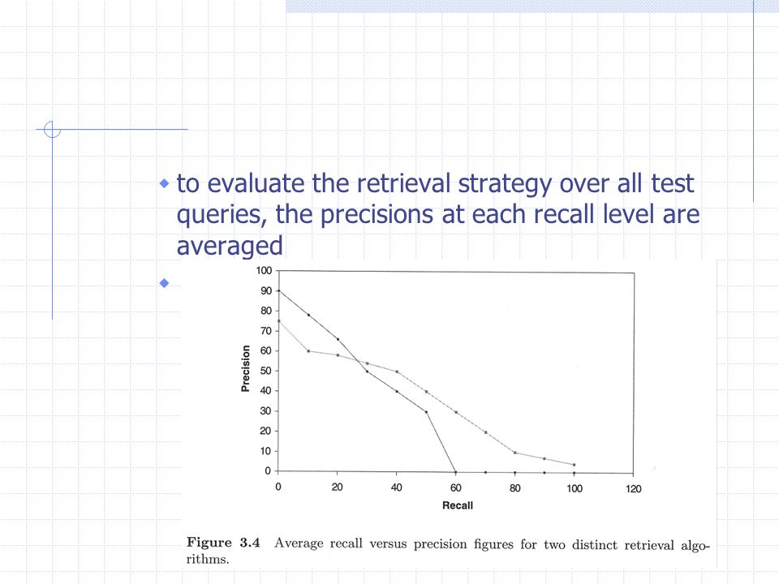

Slide 11
Single Value Summaries
Average Precision at Seen Relevant Documents:
The idea is to generate a single value summary of the ranking by averaging the precision figures obtained after each new relevant document is observed
e.g. for example 1: (1+0.66+0.5+0.4+03)/5=0.57
This measure favors systems which retrieve relevant documents quickly

Slide 12
Single Value Summaries (Cont.)
R-Precision:
The idea here is to generate a single value summary of the ranking by computing the precision at the R-th position in the ranking, where R is the total number of relevant documents.
e.g. for example 1: R-Precision is 0.4
e.g. for example 2: R-Precision is 0.3
The R-precision measure is useful for observing the behavior of an algorithms for each individual query.

Slide 13
Single Value Summaries (Cont.)
Precision Histograms:
Use R-precision measures to compare the retrieval history of two algorithms through visual inspection
RP_{A/B}(i)=RP_{A}(i)-RP_{B}(i)

Slide 14
Summary Table Statistics
Single value summary table:
Number of queries
Total number of documents retrieved by all queries
Total number of relevant documents were effectively retrieved when all queries are considered
Total number of relevant documents retrieved by all queries…

Slide 15
Precision and Recall Appropriateness
Maximum recall: Large collection??
Recall and precision: Capture different aspects
Measure the effectiveness over a set of queries processed in batch mode. (Interactivity??)
Recall and precision are easy to define when a linear ordering of the retrieved documents is enforced.

Slide 16

Alternative Measures
The Harmonic Mean:
, Values: 0,1
The E Measure:
b=1,E(j)=1-F(j)
b>1,more interested in precision
b<1,more interested in recall
1+b²
E(j)= 1-
b²
1
r(j)
+
P(j)

Slide 17
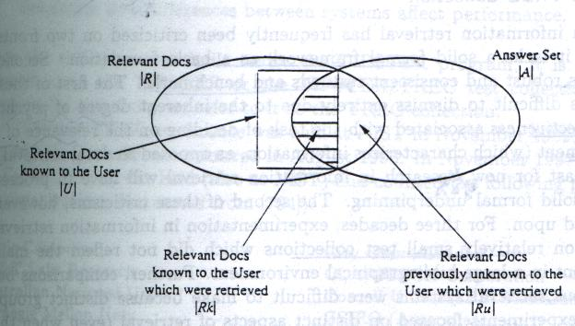
User-Oriented Measures

Slide 18
User-Oriented Measures
The fraction of the documents known (to the user) to be relevant which has actually been retrieved.
Coverage=|Rk|/|U|
The fraction of the relevant documents retrieved which was unknown to the user.
Novelty=|Ru|/|Ru|+|Rk|

Slide 19
User-Oriented Measure(cont.)
Relative recall: (Value: 1 ???)
(|Ru|+|Rk|)/ |U|
Recall effort:
The number of documents examined in an attempt to find the expected relevant documents
|U|/|Rk|

Slide 20
Reference Collections
Small Collection
The ADI Collection (documents on information science)
INSPEC (abstracts on electronics, computer, and physics)
Medlars (medial article)
The CACM Collection
The ISI Collection
Large Collection
The TREC Collection

Slide 21
The TREC Collection
Initiated by Donna Harman at NIST (National Institute of Standards and Technology) in 1990s.
Co-sponsored by the Information Technology Office of the DARPA as part of the TIPSTER Text Program

Slide 22
The Documents Collection at TREC
Resource
WSJ: Wall Street Journal
AP: Associated Press (news wire)
ZIFF: Computer Selects (articles), Ziff-Davis
FR: Federal Register
DOE, SJMN, PAT, FT, CR, FBIS, LAT
Size
TREC-3: 2GB
TREC-6: 5.8GB

Slide 23
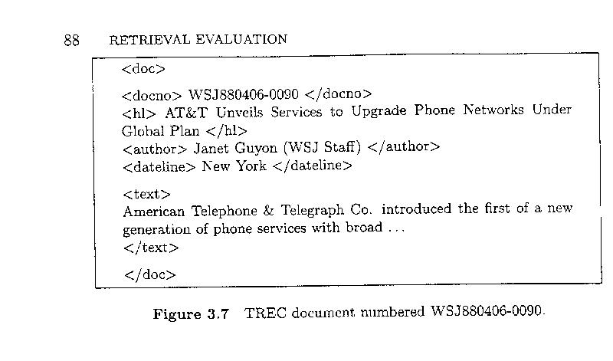
TREC document example

Slide 24
The Example Information Requests (Topics)
350 topics for the first six TREC Conference
Topic:
1-150: TREC-1 and TREC-2
long-standing information needs
151-200: TREC-3
simpler structure
201-250: TREC-4
even shorter
251-300: TREC-5
301-350: TREC-6

Slide 25
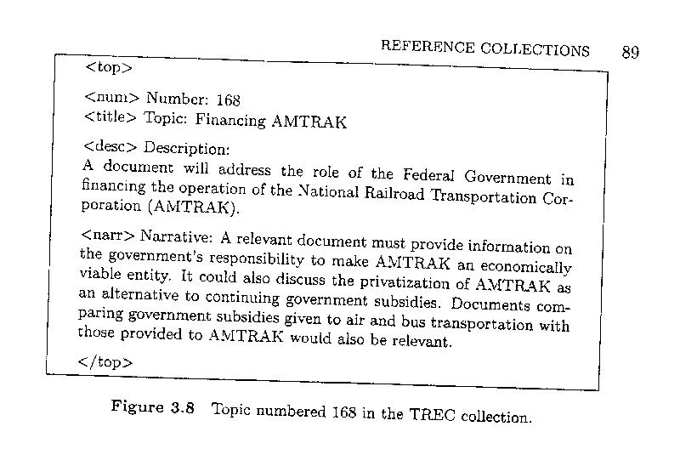
TREC Topic Example

Slide 26
The Relevant Documents for Each Topic
Pooling Method:
The set of relevant documents for each example information request (topic) is obtained from a pool of possible relevant documents.
The pool is created by taking the top K documents (usually, K=100) in the rankings generated by various participating retrieval systems.
The documents in the pool are then shown to human assessors who ultimately decide on the relevance of each document.

Slide 27
The Tasks at the TREC Collection
Ad hoc task
Routing task
TREC-6
Chinese
Filtering
Interactive
NLP
Cross Languages
High precision
Spoken document
Very large corpus

Slide 28
Evaluation Measures at the TREC Conference
Summary table statistics
the number of topics, the number of relevant documents retrieved,
Recall-Precision Averages
11 standard recall levels
Document level averages
5, 10, 20, 100,
Average precision histogram
R-precision

Slide 29
Example 1
Rq= {d₃,d₅, d₉,d₂₅,d₃₉,d₄₄,d₅₆ , d₇₁,d₈₉,d₉₄,d₁₀₅,d₁₁₉,d₁₂₄,d_{136,} d₁₄₄}
Aq ={d₁₂₃,d₈₄,d₅₆,d₆,d₈,d₉,d₅₁₁,d₁₂₉,d₁₈₇,d₂₅,d₃₈,d₄₈,d₂₅₀,d₁₁₃ , d₄₄,d₉₉,d₉₅,d₂₁₄,d₁₃₆,d₃₉,d₁₂₈,d₇₁,d₁₄,d₅}
Calculate recall and precision values for all relevant documents.

Slide 30
Example 1
Calculate interpolated precision at 30%, 60% and 90% recall levels.
Calculate average precision at seen relevant documents ( for first 4 and first 6 documents).
Calculate R-precision.

Slide 31
Example 2: Compare performance of two IR algorithms for the same query q.
Rq= {d₃,d₅, d₉,d₂₅,d₃₉,d₄₄,d₅₆,d₇₁,d₈₉, d₉₄,d₁₀₅,d₁₁₉,d₁₂₄,d_{136,} d₁₄₄}
Aq ={d₁₂₃,d₈₄,d₅₆,d₆,d₈,d₉,d₅₁₁,d₁₂₉,d₁₈₇,d₂₅,d₃₈,d₄₈,d₂₅₀,d₁₁₃ , d₄₄,d₉₉,d₉₅,d₂₁₄,d₁₃₆,d₃₉,d₁₂₈,d₇₁,d₁₄,d₅}
Rq= {d₄,d₆, d₁₀,d₂₆,d₄₀,d₄₅,d_{57,} d₆₁,d₇₂,d₉₀, d₉₅,d₁₀₆,d₁₂₀,d₁₂₅,d_{137,} d₁₄₅}
Aq ={d₁₂₃,d₄₀,d₅₆,d₆,d₈,d₁₀,d₅₁₁,d₁₂₉,d₄₅,d₂₆,d₃₈,d₄₈,d₂₅₀,d₁₁₃ , d₄₄,d₉₀,d₉₅,d₂₁₄,d₁₃₆,d₁₄₅,d₁₂₈,d₂₅,d₇₂,d₁₄,d₅}

Slide 32
Example 3
Calculate harmonic mean for d56 and d39.
Calculate E- measure for d56 and d39. (All three cases b=1, b>1 , b<1)

